Slide 1
Status Report
2015. 11. 11
Nam Jong Woo

Slide 2
Action Item
Muon plots without each cut
Include Ratio plot
M60to120

Slide 3
Exclude Each Cut
isGLB == 1 | Reconstructed as a Global Muon
isPF == 1 | Particle Flow Muon the exclusive effect of this requirement is very small
chi2dof < 10 | χ2/ndof of the global-muon track fit < 10
muonHits > 0 | At least one muon chamber hit included in the global-muon track fit
nMatches > 1 | Muon segments in at least two muon stations This implies that the muon is also an arbitrated tracker muon
abs(dxyVTX) < 0.2 | Its tracker track has transverse impact parameter dxy < 2 mm w.r.t. the primary vertex
abs(dzVTX) < 0.5 | The longitudinal distance of the tracker track wrt. the primary vertex is dz < 5 mm
pixelHits > 0 | Number of pixel hits > 0
trackerLayers > 5 | Cut on number of tracker layers with hits >5
trkiso < 0.10 | (∑pT(TRK))/pT < 0.10

Slide 4
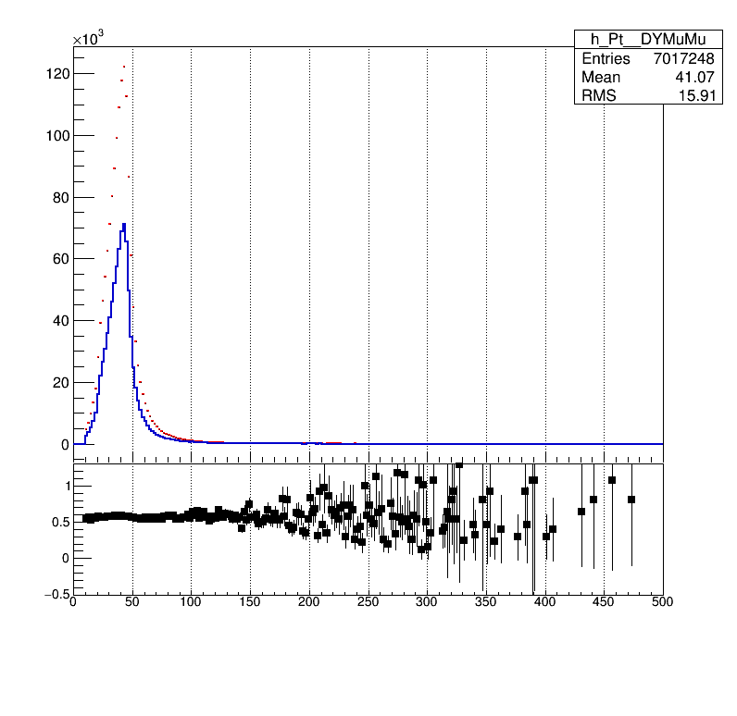
Without isGLB

Slide 5
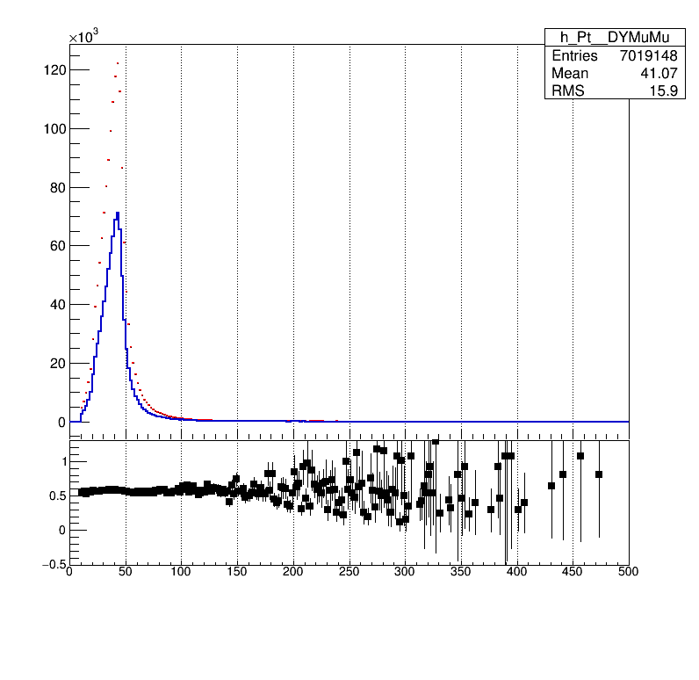
Without isPF

Slide 6
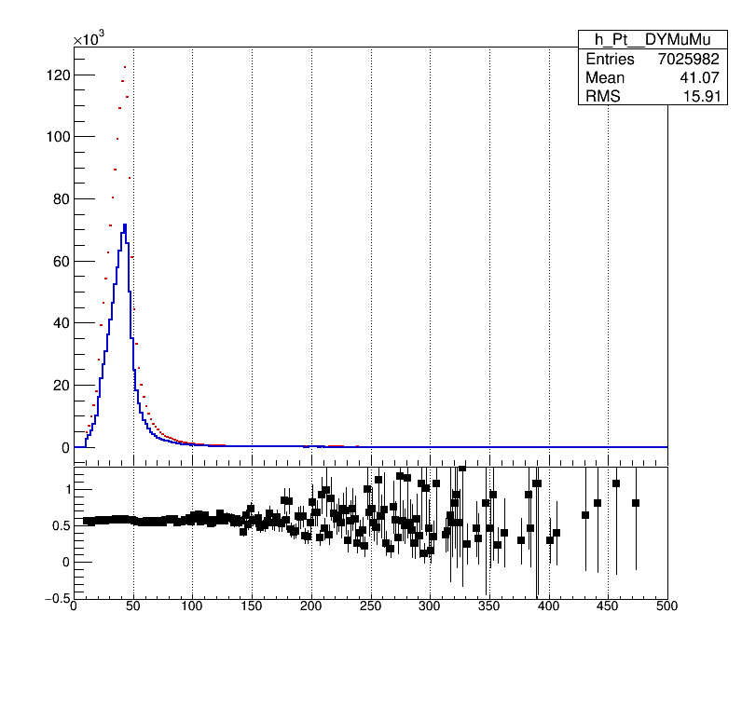
Without muonHits

Slide 7
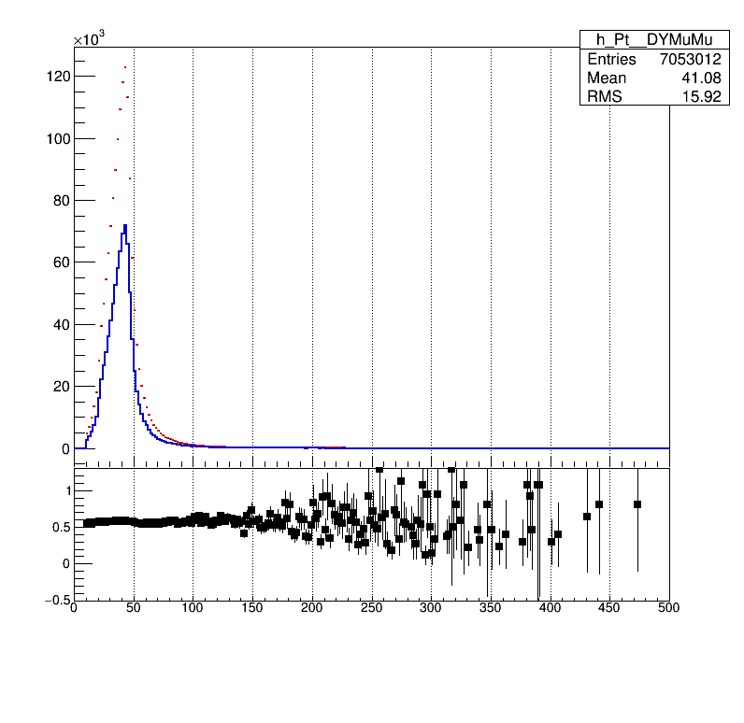
Without chi2dof

Slide 8
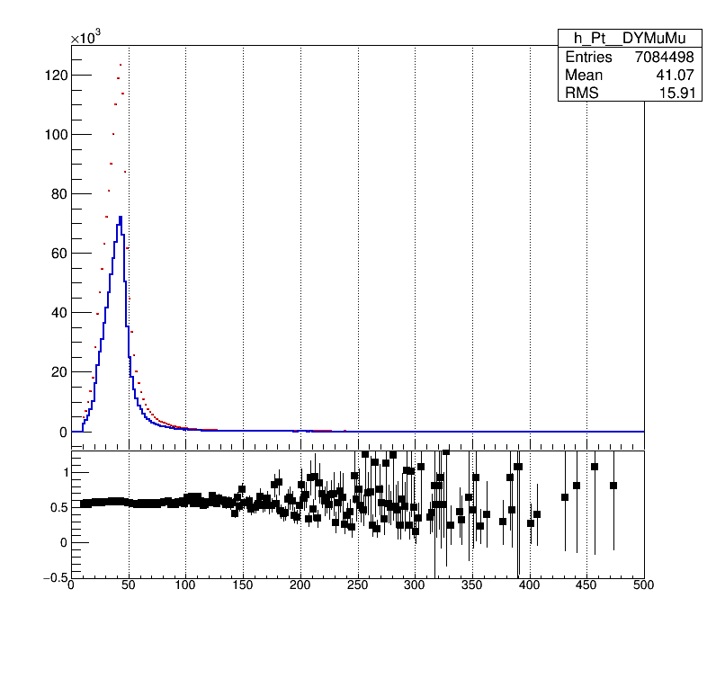
Without nMatches

Slide 9

Without dxyVTX

